Slide 1
Incorporating a ChatGPT powered assistant into TPV
By
Alexis Huante & Vilen C. Elliott

Slide 2
Overview
Introduction
Case Diagram
Methodology
Challenges
Future Work
Demo

Slide 3
Introduction
Chatbots are being integrated into several application systems, such as banking, marketing, and healthcare.
They are becoming more and more reliable, ChatGPT-4.
Implement ChatGPT into the TPV tool by Dr. Mustafa Al Lail, Antonio Rosales, and Hector Cardenas

Slide 4
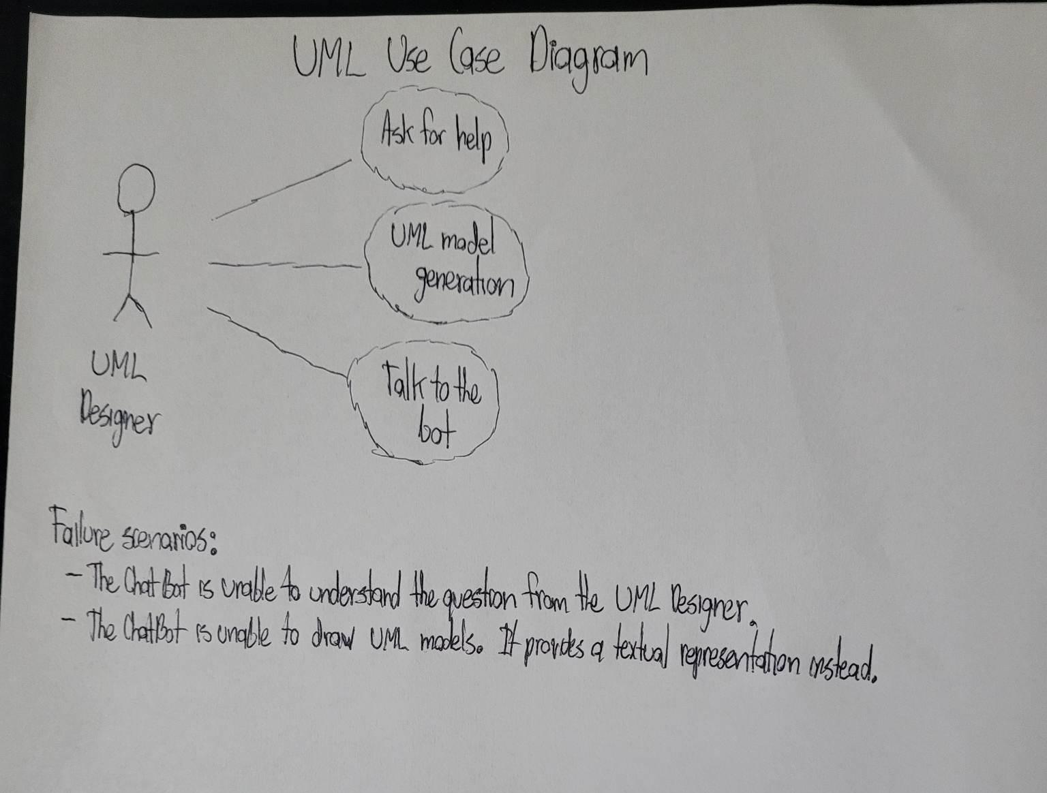
Case Diagram

Slide 5
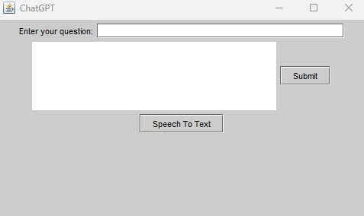
Methodology
Creation of ChatGPT in Java:
GitHub repository by Antoine Gauthier as a reference.
Download JSON dependency (json-20220924.jar)
Create OpenAI account to receive a key and include it in the code.
Creation of GUI in JavaSwing.

Slide 6
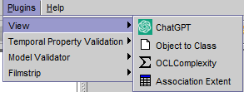
Methodology Part 2
Implementation of ChatGPT into the TPV tool:
GitHub repository by Andreas Kastner and Lars Hamann as a reference. (Includes examples of plugins)
Change following files: build.xml, useplugin.xml, manifest.mf, and ChatGPTPlugin.java (code).
Run the build.xml using ant command in the CMD.
JAR plugin will be created, move it to the plugins folder from the TPV tool, and run USE.

Slide 7
Problems Encountered
We encountered several challenges during the development of the plugin.
We needed to learn new aspects of Java to complete the project, such as structuring the project in a way that was compatible with the TPV software. Additionally, we had to learn how to export the code as a JAR and add it into the TPV plugin folder, which involved ensuring that all the necessary dependencies were included in the JAR file. Despite these challenges, we were able to create the plugin and include the chatbot into the TPV software.

Slide 8
Future Work
Creating a better user interface: In future iterations of the project, we plan to invest more time and resources into creating a more clean and user-friendly interface that will make it easier for users to interact with the chatbot.
Adding Text-to-Speech & Speech-to-Text support: Currently, the chatbot only supports text-based interactions. In order to improve the user experience and make the chatbot more accessible, adding support for Text-to-Speech and Speech-to-Text capabilities will allow users to interact with the chatbot using their voice.
Teaching ChatGPT about TPV software: While ChatGPT is a powerful language model, it currently lacks knowledge about the TPV software, we plan to invest more time into teaching ChatGPT about TPV software. This will involve training the language model on relevant data and integrating specific knowledge into its responses.

Slide 9
Demo

Slide 10
Questions?

Slide 11
References
https://github.com/useocl/use_plugins by Andreas Kastner and Lars Hamann
https://gist.github.com/gantoin/190684c344bb70e5c5f9f2339c7be6ed by Antoine Gauthier

